Slide 1
BATTLE OF NEIGHBORHOODS
KIRANDEEP KAUR

Slide 2



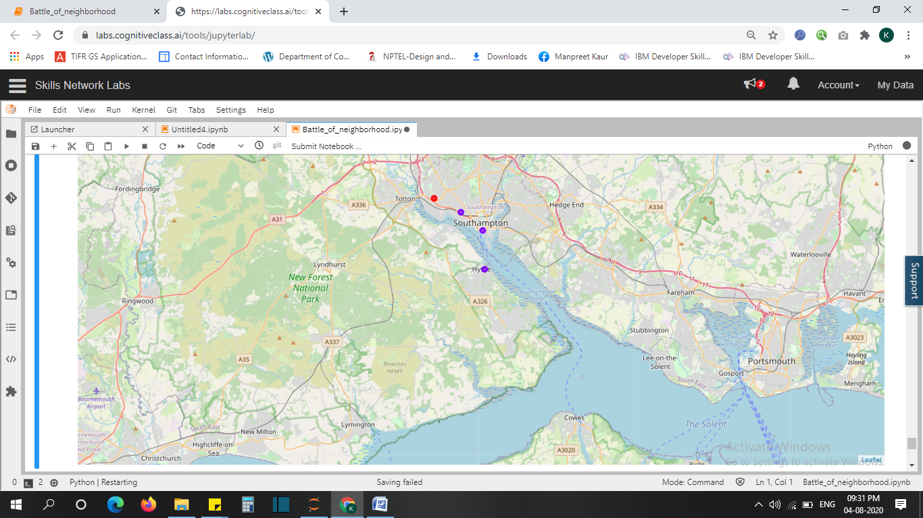
PROVIDING RECOMMENDATION USING DATA SCIENCE CAN BE HELPFUL
Exploring Southampton and each of its streets for a cheap house
Using Foursquare API to explore other venues like food restaurants and pubs.
-Helping the customer by recommending a house within his/her budget with nearby facilities of food venues if he/she does not prefer cooking.
Great visualizations through graphs , charts and Southampton map

Slide 3



Data acquisition and cleaning
Used "HM Land Registry" dataset of UK for 2020 provided by UK govt at https://www.gov.uk/government/statistical-data-sets/price-paid-data-downlads
Used Foursquare API for latest updates and announcements regarding places of interest in Southampton
Columns of dataset were renamed and rows related to Southampton city were retrieved changing data set size from 77588 rows and 16 columns to 76397 rows and 16 columns

Slide 4
DATA ANALYSIS

Slide 5
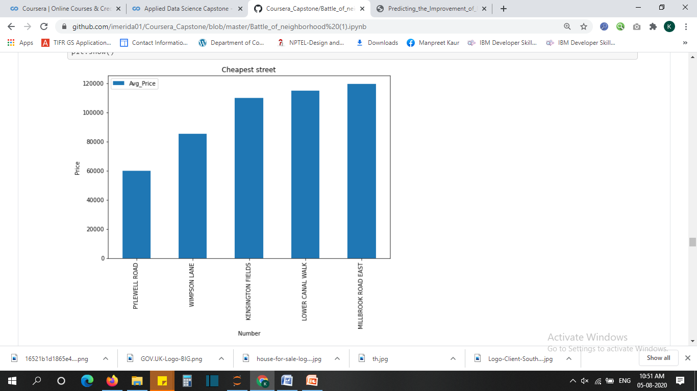
Visualizing top 5 streets of Southampton with cheapest average prices using a bar graph

Slide 6
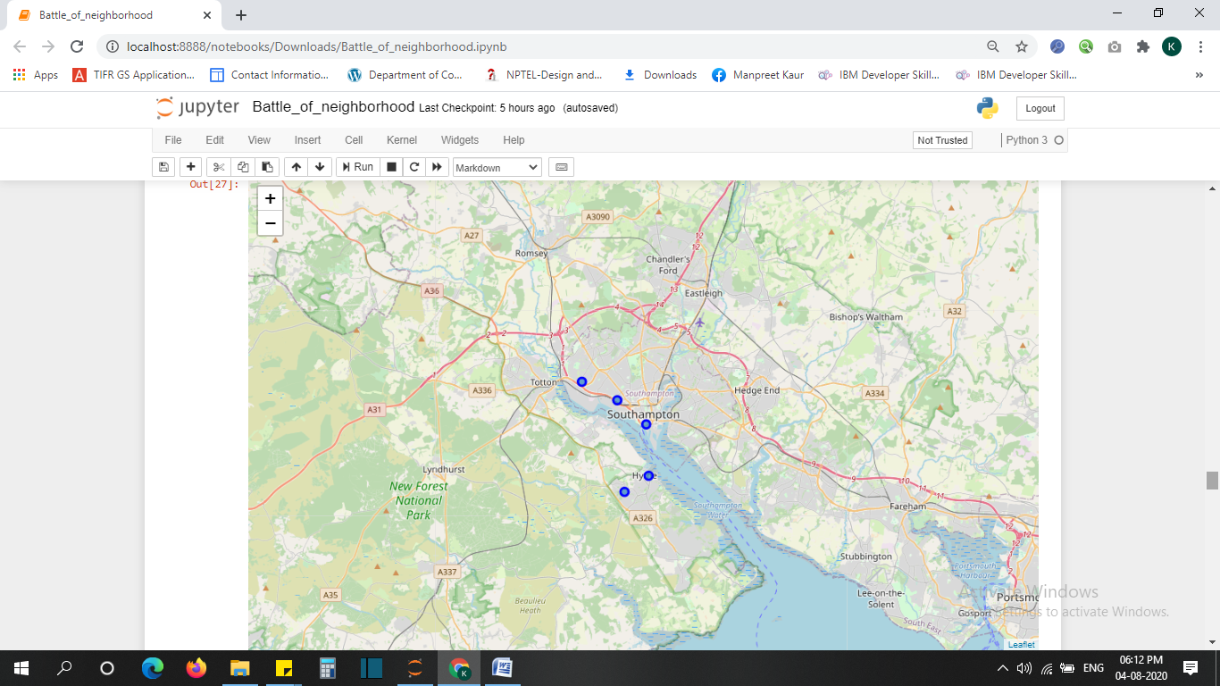
These Five streets we retrieved as the streets of interest along with their geo locations shown on the Southampton map

Slide 7
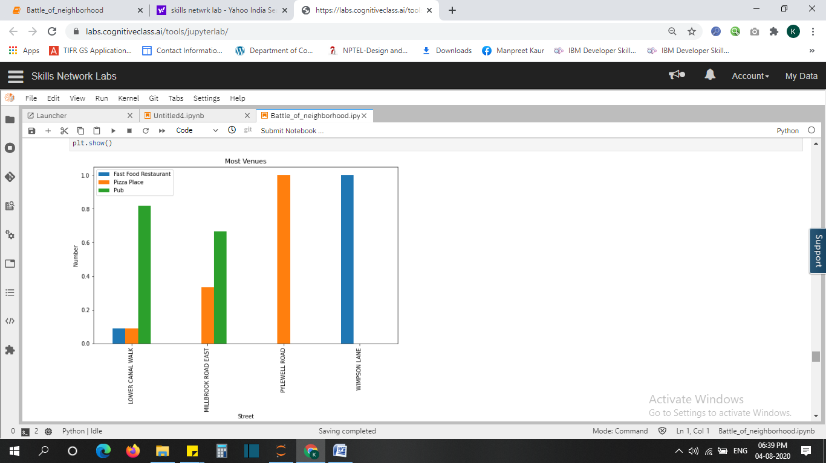
This bar graph – ‘Most Venues’ clearly shows the comparison of neighboring streets with respect to the availability of namely three venues – fast food restaurants , Pizza place and pubs.

Slide 8
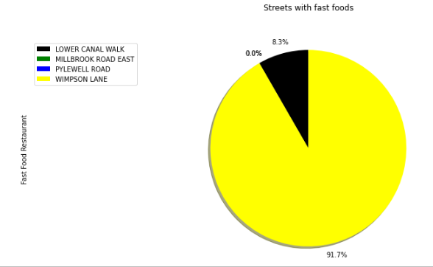
This pie chart shows the comparison of five streets with respect to the availability of Fast food restaurants in terms of percentage.

Slide 9
CLUSTERING

Slide 10
Using k-means clustering the streets were divided into two clusters as shown in the map.

Slide 11
Conclusion
From data analysis it was concluded that the customer should buy a house in WIMPSON LANE at an average price of 85500.0 where he/she will get maximum benefits of Fast Food restaurants in comparison to any other neighboring streets.

